Slide 1

ICEG
Open Standards
Process and method
October, 11th 2019

Slide 2
Content
Welcome
Process
Existing practices
Formal High Level process
End-to-End Governance
Detailed subprocesses
Method
What’s next?

Slide 3






Existing practices

Slide 4
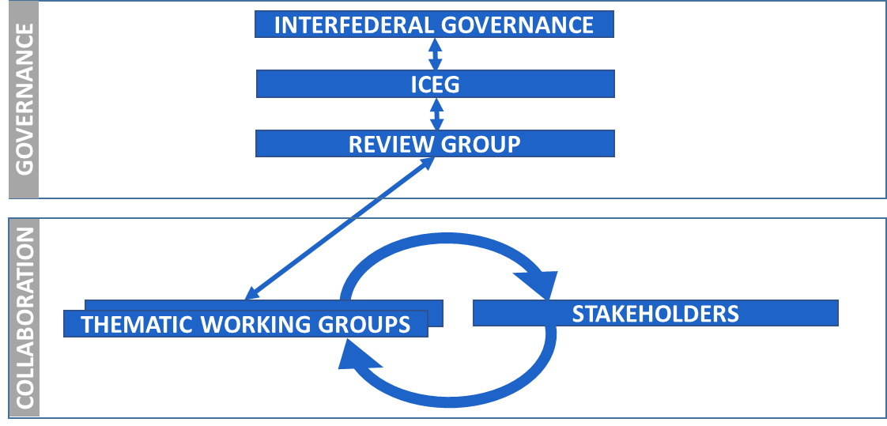
End-2-End governance

Slide 5
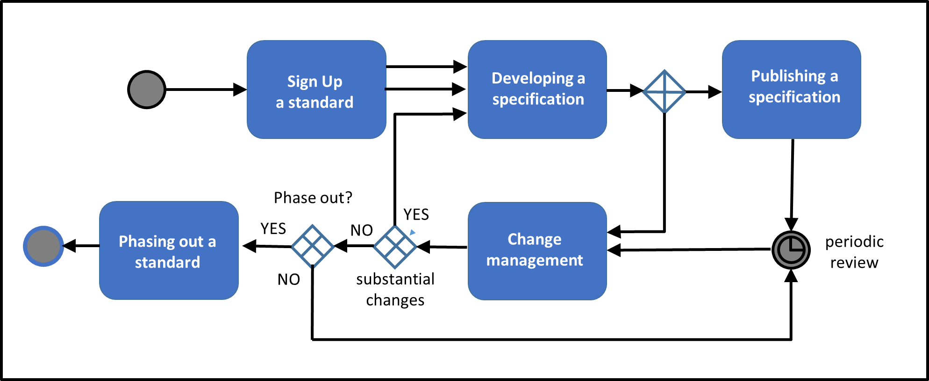
Process and method
W3C, IEEE, IETF, IAB en ISA, Open Stand, OSLO

Slide 6
Subprocesses
Announcement
Development
Publication
Change management

Slide 7
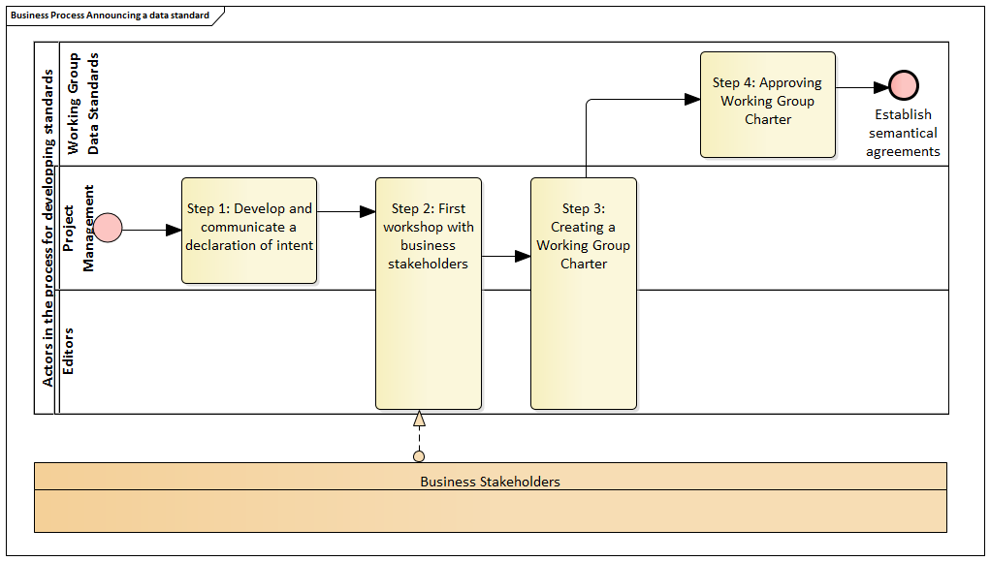
Announcing a standard

Slide 8
Announcing a standard
Step 1. declaration of intent:
What is the added value of the standard?
Link with existing standards at regional, federal, European or global level?
Which standards and sources already exist?
Who are the stakeholders
Step 2. Invite relevant and interested business stakeholders to a workshop meeting
identify processes
identify use cases

Slide 9
Announcing a standard
Step 3. Further develop declaration of intent into a Working Group Charter by adding requirements and conditions based on input from the business
Goals of the thematic working group
Scope and evaluation criteria
Duration
Deliverables
Milestones
Step 4. Present the Working Group Charter to the Permanent ICEG Working Group Data Standards for approval for starting a thematic working group

Slide 10
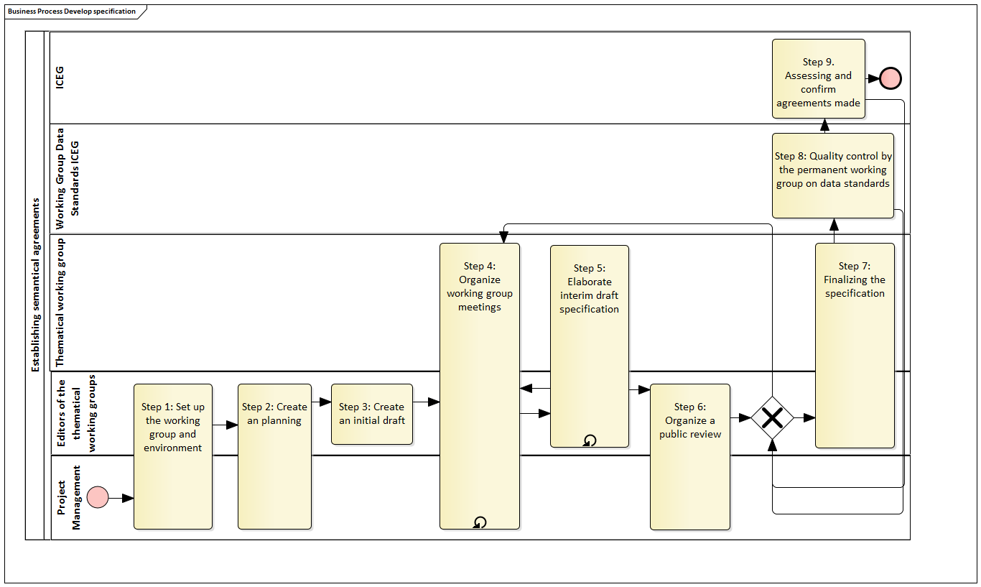
Development of a specification

Slide 11
Development of a specification
Step 1. Set up the working group and environment
Step 2. Creating an initial draft
Publish the drafts on belgif.be with each new version
Step 3. Organizing the working groups
Meeting minutes are made publicly available
Step 4. Elaborate interim draft specification

Slide 12
Development of a specification
Step 5. Mid-term evaluation by the data standards working group
Step 6. Organizing a public review
All interested parties can give feedback
Step 7. Finalizing the specification
Step 8. Quality control by the permanent working group on data standards
Step 9. Assessing and confirm agreements made

Slide 13
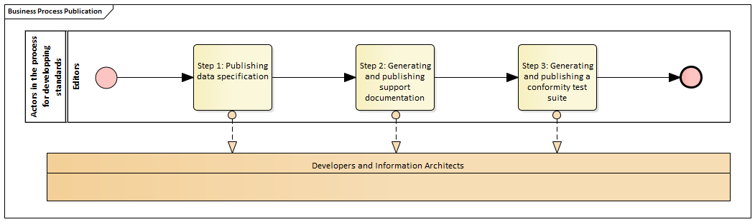
Publication

Slide 14
Publication
Step 1. Publishing specification in both human and machine readable format on belgif.be
Step 2. Publishing reusable elements that project teams can make use of
Step 3. Publishing a conformity test suite

Slide 15
Types of changes
Editorial changes and errors: no impact, for example additional clarification, typing errors, etc.
Minor substantive changes: such as the addition of a property: (possible) impact on implementations, but a small impact.
Major substantive changes: impact fundamental matters in the specification and underlying specifications, for example by changing a definition

Slide 16
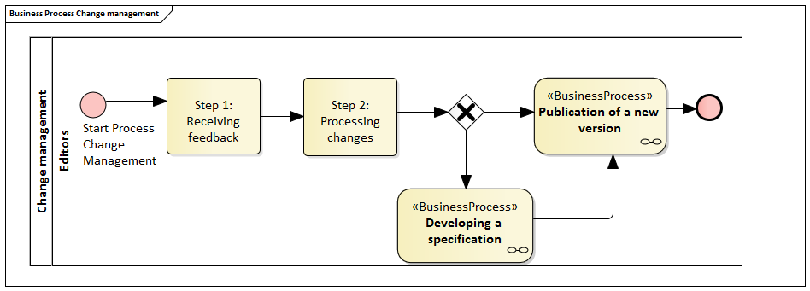
Change management

Slide 17
Change management
Step 1. Receiving feedback
Step 2. Processing changes
Step 3. Publication of a new version

Slide 18
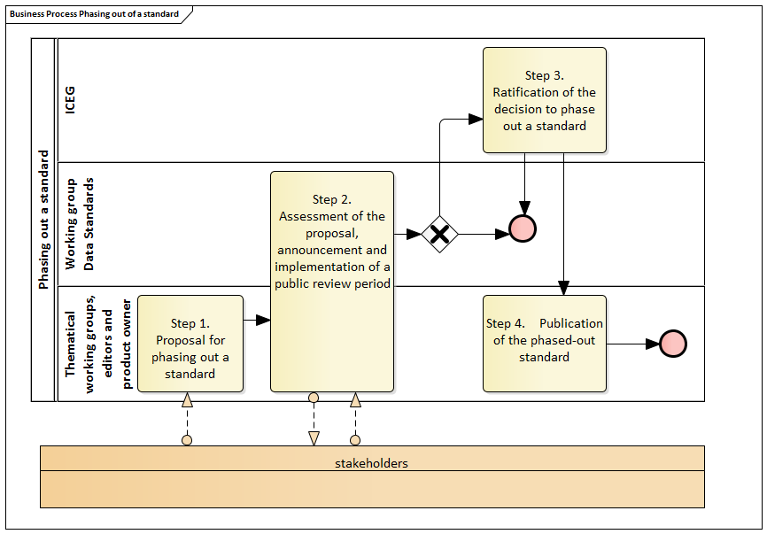
Phasing out a standard

Slide 19
Phasing out a standard
Step 1. Proposal for phasing out a standard
Step 2. Assessment of the proposal, announcement and implementation of a public review period
Step 3. Ratification of the decision to phase out a standard
Step 4. Publication of the phased-out standard

Slide 20
Method
The method describes following parts of the process:
Setting up a Working Group Charter
Organising and facilitating working group meetings
Developing a domain model
Supporting transparency during development
Generation of the data specification
Management of issues and errors

Slide 21
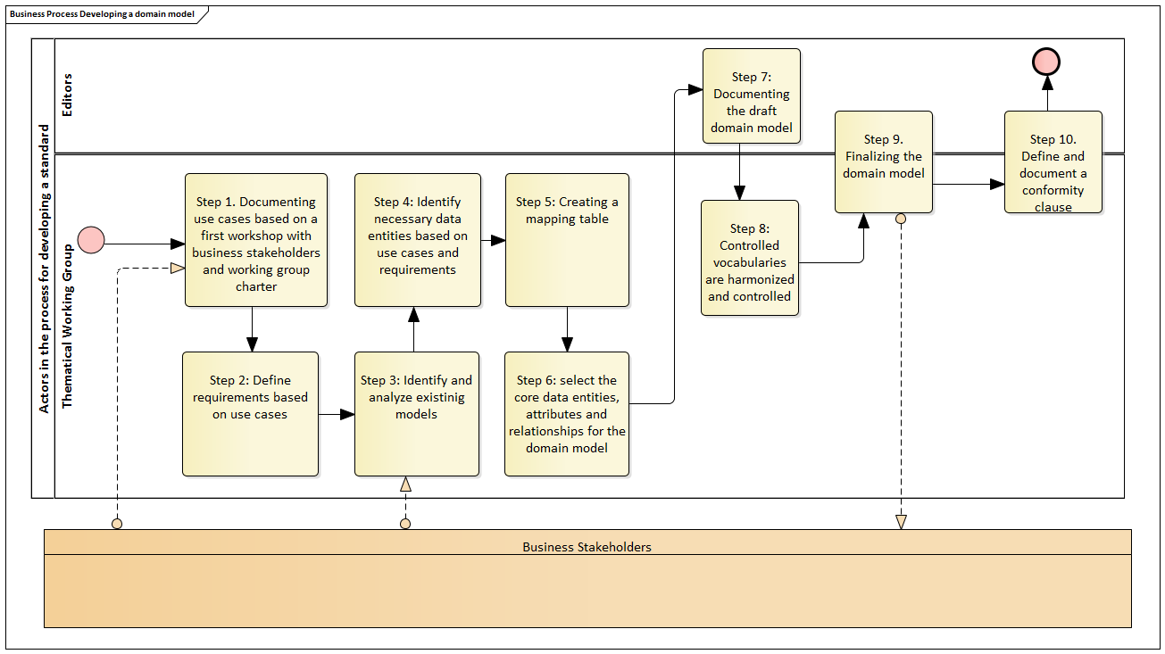
Developing a domain model

Slide 22
Github
https://github.com/belgif/review
https://github.com/belgif/thematic
By default everything public (read-only)
Adding issues/comments to Github:
Create a (free) account on Github.com
Notify BOSA (Bart, Marc) to get write-access

Slide 23
Calendar for the rest of 2019
11 Oct (14-16hr): meeting 1 thematic wg URI (organizer CFWB)
8 Nov: meeting 2 thematic wg URI (organizer BOSA)
22 Nov: meeting 3 thematic wg URI (organizer Flanders)
30/11-31/1 public review URI
(organizer takes care of invitation, meeting room, minutes of meeting)

Slide 24
Possible topics for next thematic workgroups
Diplomas and school enrolments
Mandates and authorizations
Person data
Coupling parcels (Fed.) – address/building unit (regional)
BEST address

Slide 25
What’s next
Q. : How will we communicate on new standards?

